Slide 1


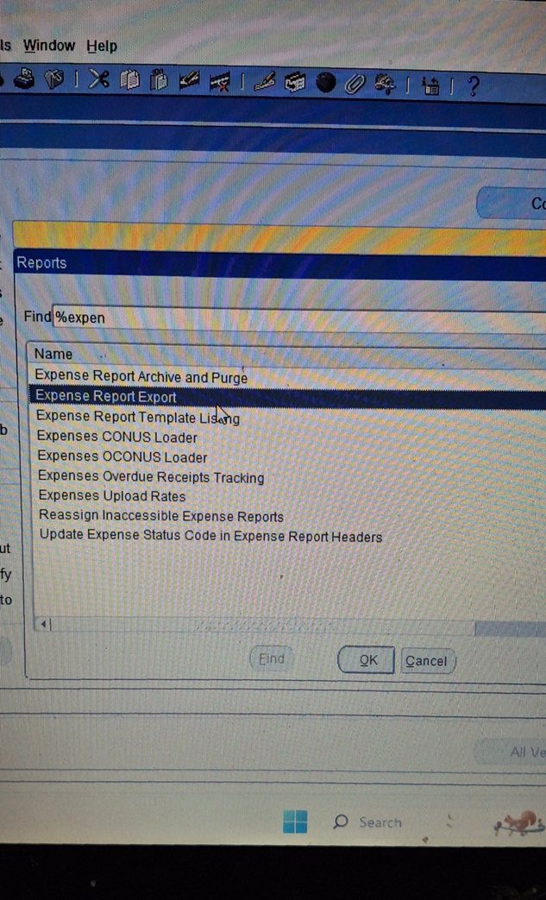
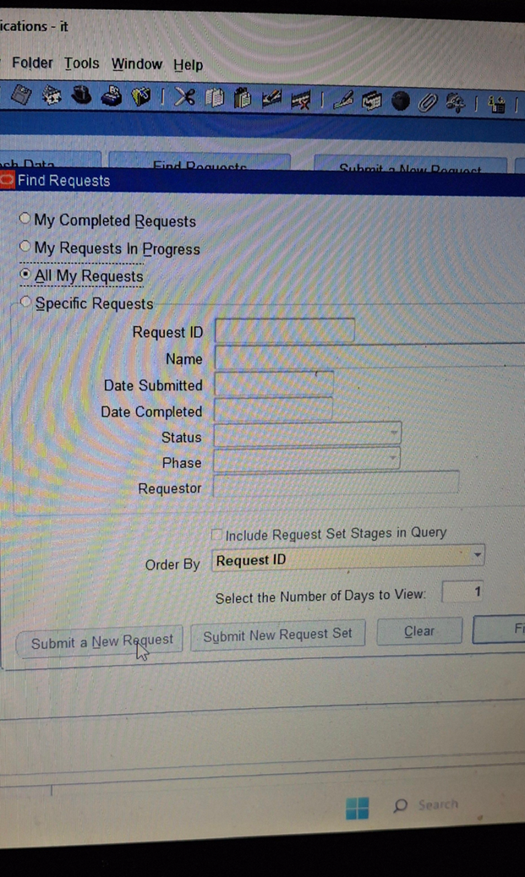
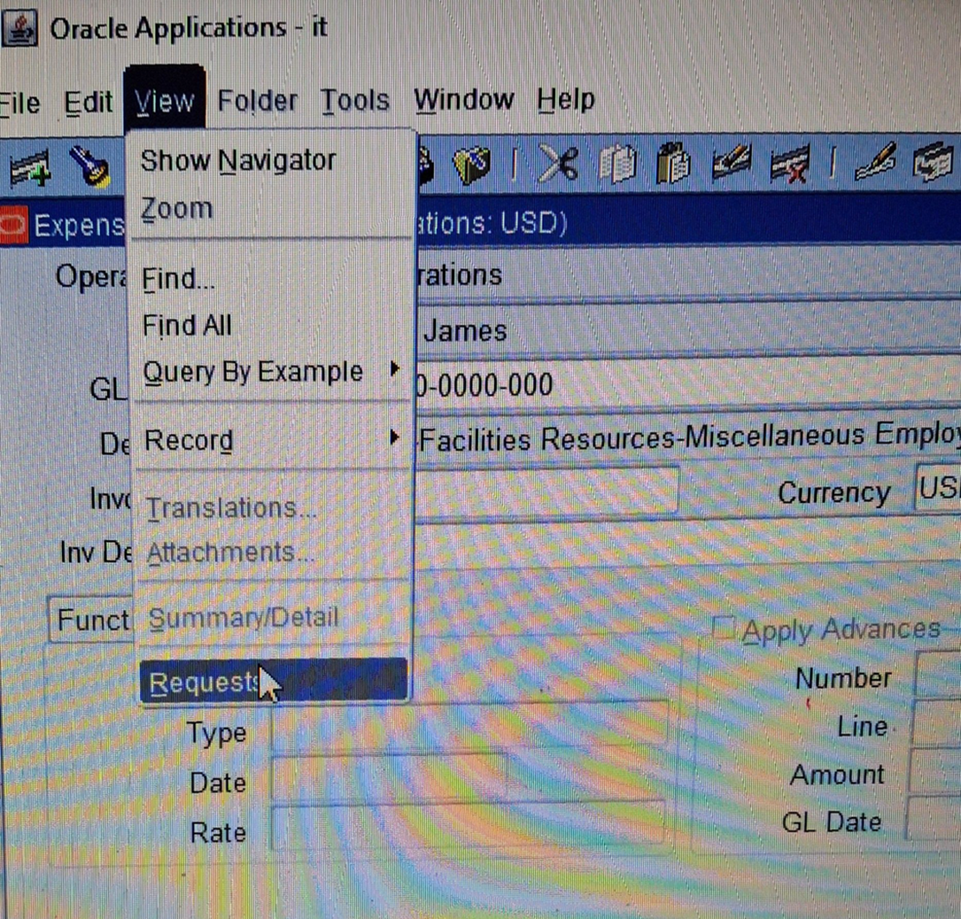
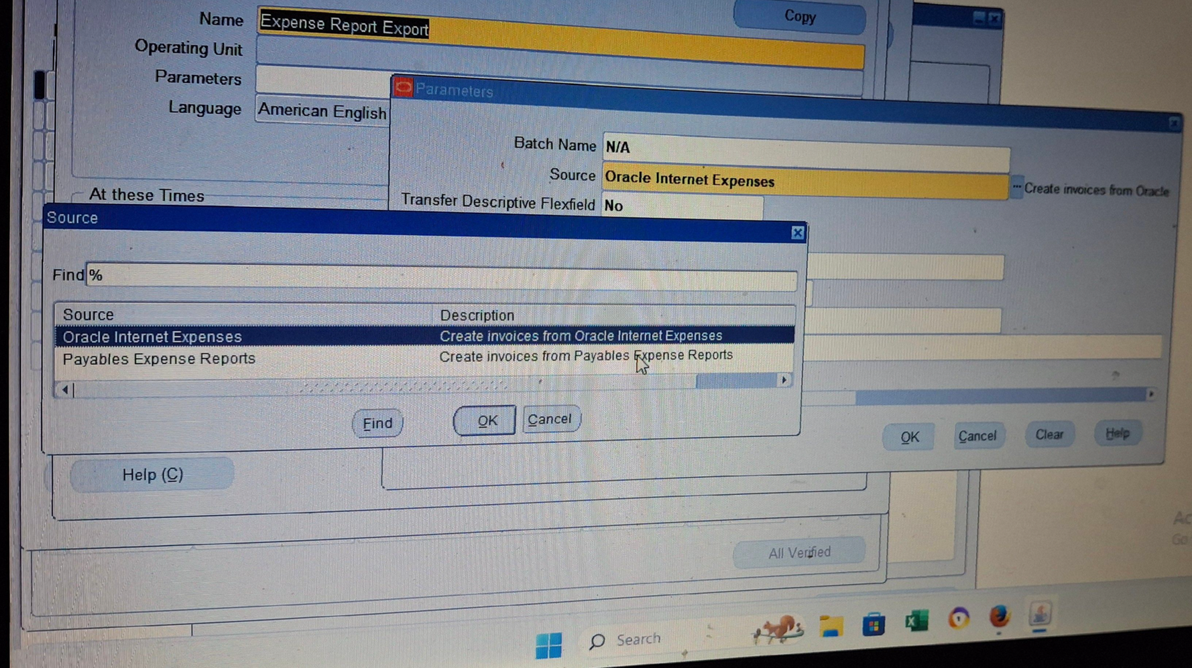
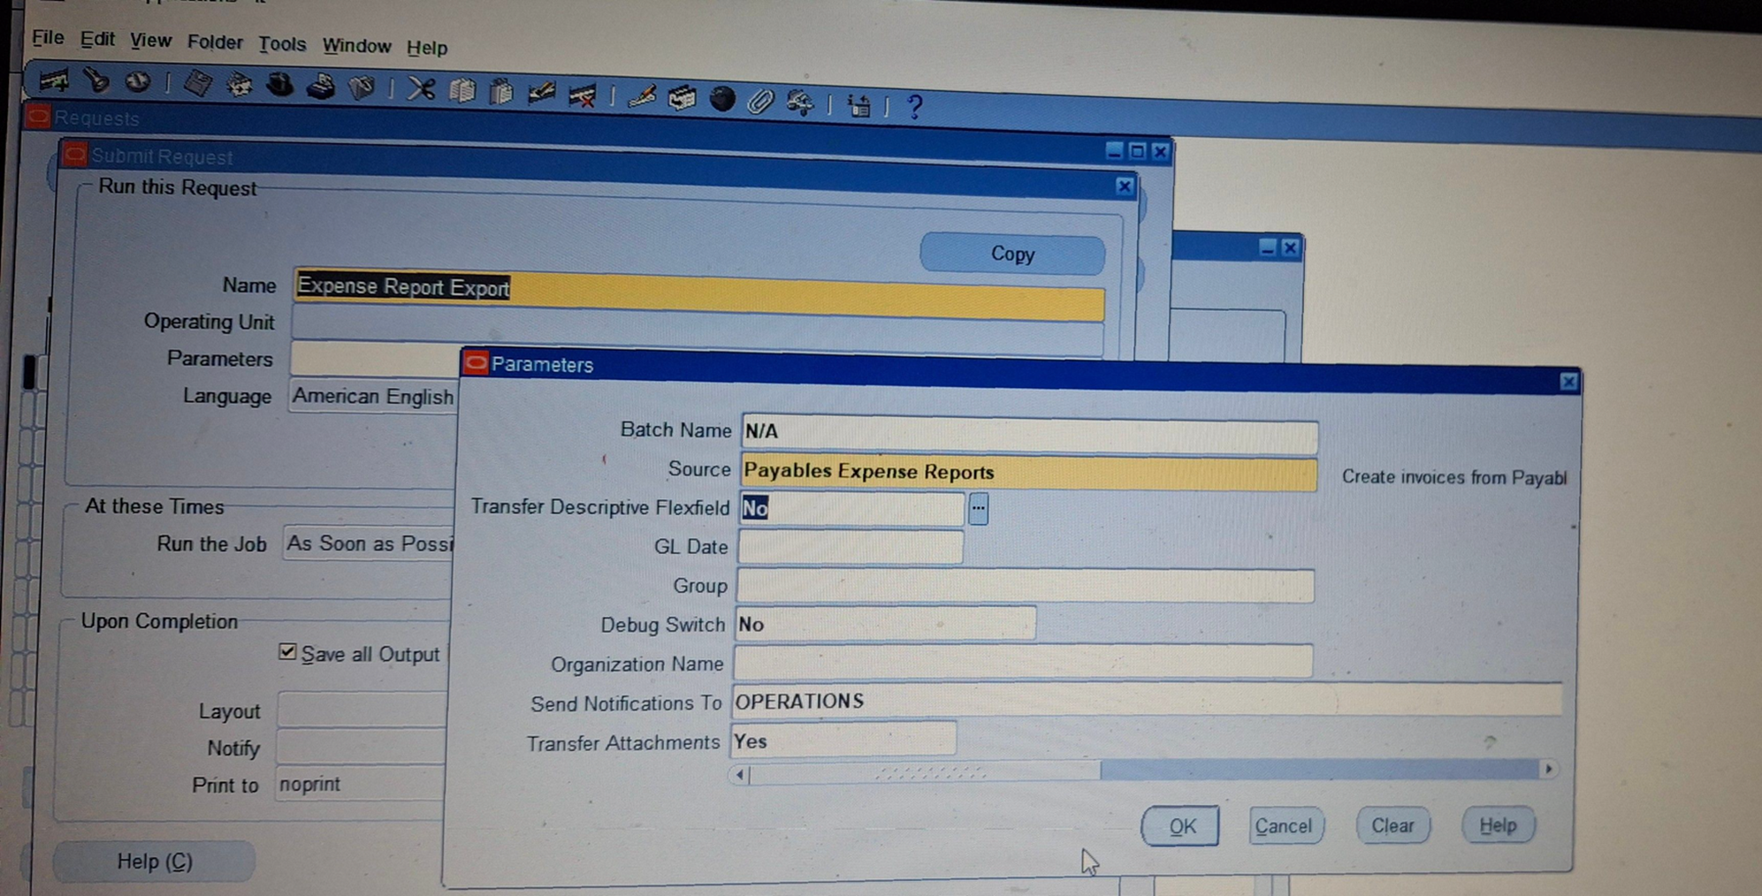
Create and Manage Supplier Invoices
Expense Report from invoice
View > Request > Submit anew Request​
Find > Expense Report Export > OK​
︎ Source > Payable Expense Reports >Ok
Transfer Descriptive Flexfield [No]​
《Debug Switch 》 [No]​
《Transfer Attachments》[ Yes ]
26

